Slide 1
GIB Recovery Program: Visual Insights
Visual Data Deck on Mortality, Habitat, and Conservation Actions
(2016–2024)

Slide 2
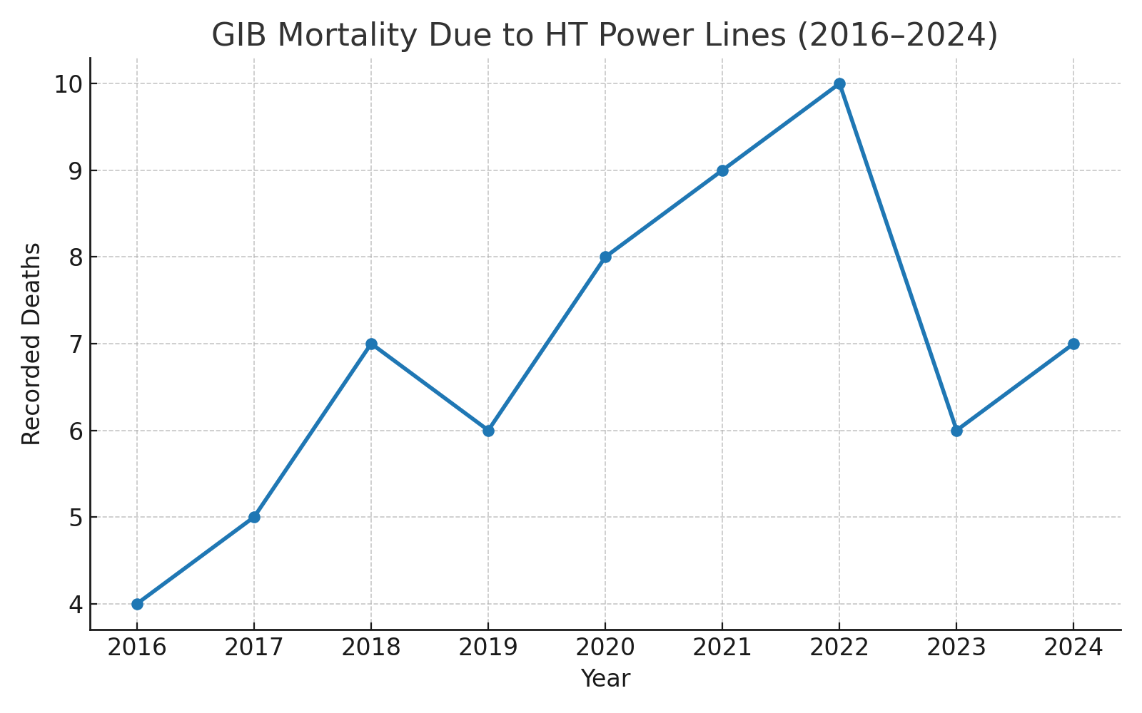
GIB Mortality Due to HT Power Lines (2016–2024)

Slide 3
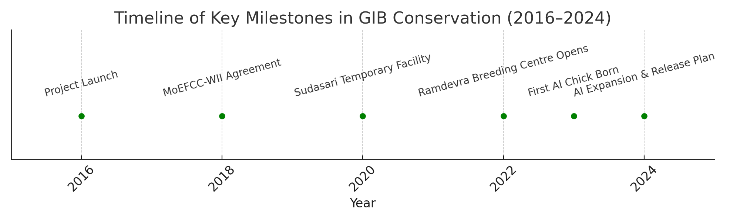
Timeline of Key Milestones in GIB Conservation

Slide 4
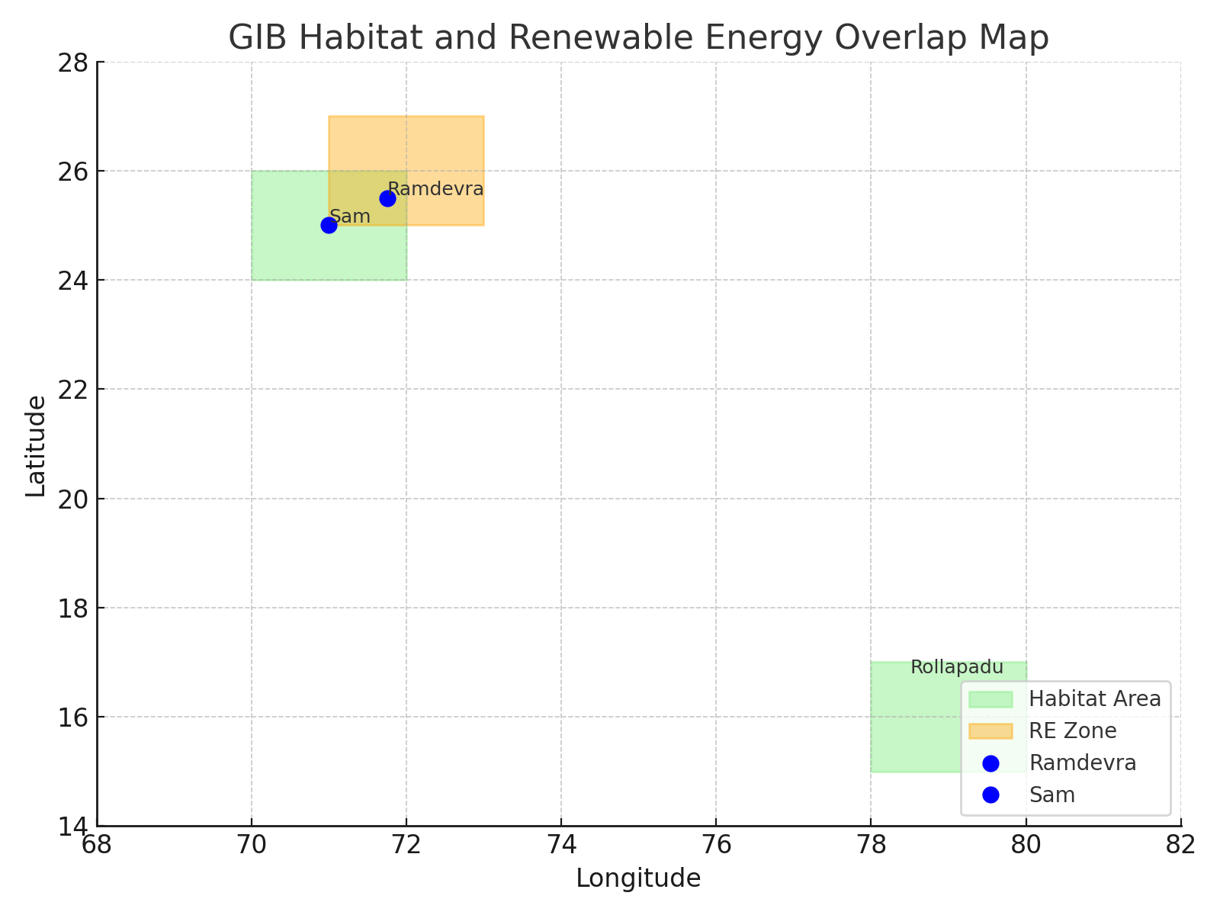
GIB Habitat and Renewable Energy Overlap Map

Slide 5
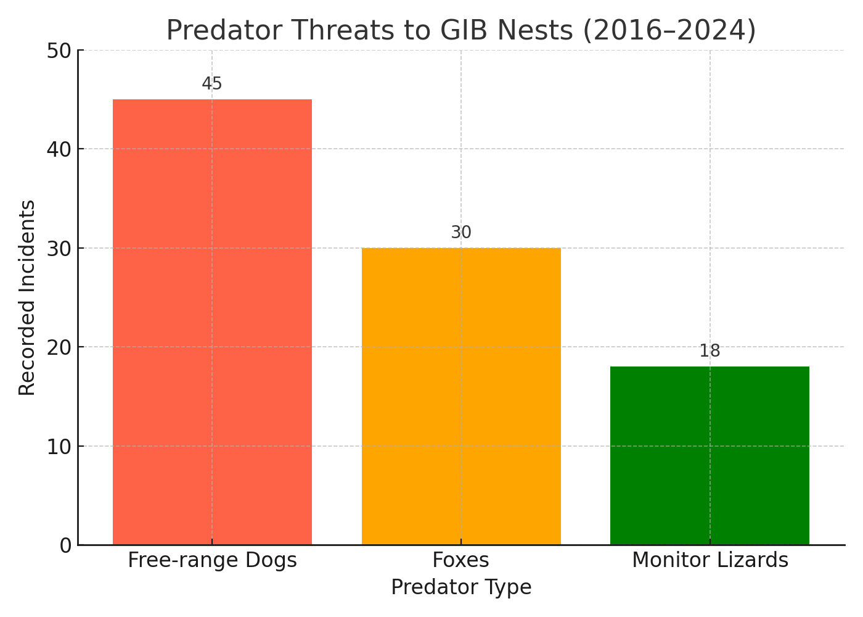
Predator Threats to GIB Nests (2016–2024)

Slide 6

Captive Breeding & Release Flowchart

